Slide 1

Voice Based application for Visually impaired people
DEEPTHI.R(1BM16CS030) HARINI.B.M(1BM16CS033)
KRITHIKA.G.M(1BM16CS043) ZAINA AHAD(1BM16CS149)
PRADEEP SADANAND
ASSISTANT PROFESSOR
Department of Computer Science and Engineering
B.M.S College of Engineering

Slide 2
OUTLINE
Problem Statement
High level Design
Detailed Design
Implementation
Results/Snapshots of the output
Testing
Conclusion and Future Enhancements
Paper Published
References

Slide 3
PROBLEM STATEMENT
The aim of the project is to help the visually impaired people to compose and send emails. The main focus of the system is to develop a mobile based voice e-mail system with Secure Password Manager for visually impaired people.
IBM’s Application has an easy-to-use interface and converts the text-to-speech.
However, the disadvantage of this is that the developer has to design a complex new interface for the complex graphical application to be browsed and for the screen reader to recognize.

Slide 4
PROBLEM STATEMENT
Shruti-Drishti and Web-Application for Blind are the two web applications that are used by Blind people to access the internet including the emails.
Both the systems are integrated with Indian language ASR and TTS systems. But the available systems are not portable for small devices like mobile phones.
The proposed system is a voice recognizing application for mobile phones that allow access to send an E-mail and will make it possible for visually impaired people to connect with the society.
This system comes with Secure Password Management system which store the password in web server in encrypted form and when the user need the password, user can retrieve the password through voice command. This system comes with low battery alert and Remainder management as well.

Slide 5
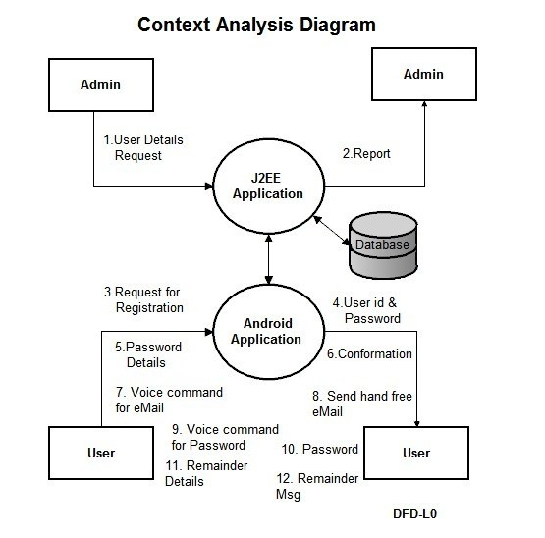
HIGH LEVEL DESIGN
The figure illustrates the high level system architecture of the application. From the figure it can be seen that the web server and the android application are interacting through the wireless application protocol(WAP). The application consists of a web interface used by the admin. This web interface has access to the password database which consists of the password details in an encrypted format. The admin will have the provision of viewing the passwords in the decrypted format. The other part of the application is the android application which enables a user to login and perform various functions such as composing and sending voice enabled emails, checking remainders and getting alerts for the battery percentage.

Slide 6
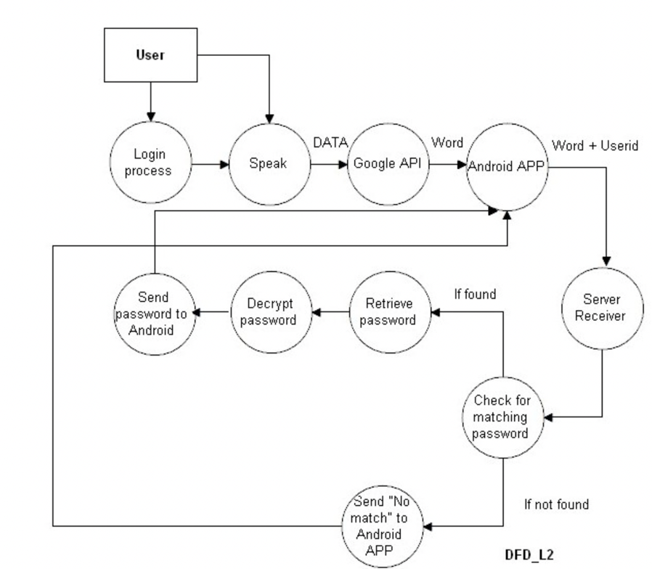
DETAILED DESIGN
The following figure shows flow of activities for the password retrieval process

Slide 7
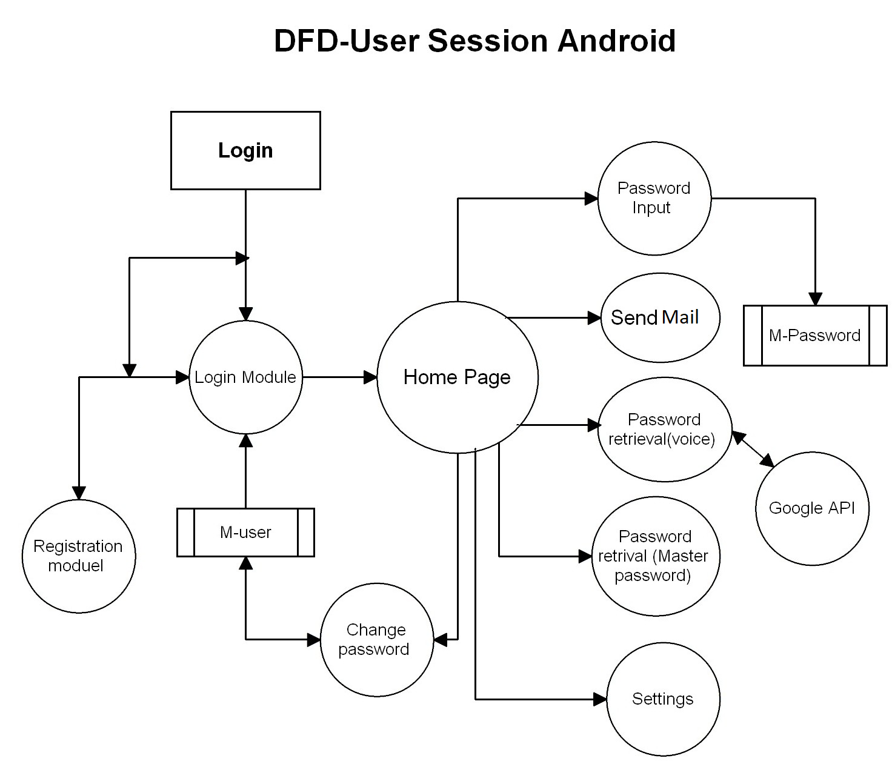
DETAILED DESIGN
The following figure shows the flow of events for the Android user session

Slide 8
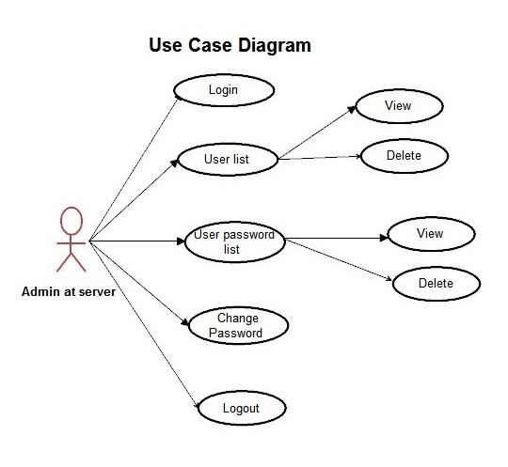
USE CASE DIAGRAM

Slide 9
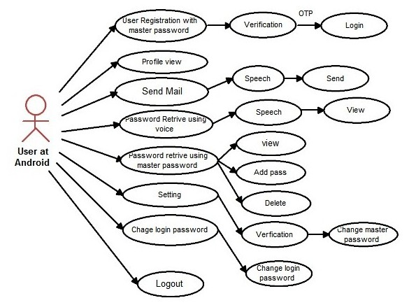
USE CASE DIAGRAM
The following figure describes the use cases if the android application user. The user on successful login will be able to view profile information, send voice enabled e-mails, retrieve passwords using voice commands and master password, change certain settings in the profile and logout.

Slide 10
IMPLEMENTATION
Advanced Encryption Standard (AES) Algorithm :
The features of AES are as follows :
Symmetric key symmetric block cipher
128-bit data, 128/192/256-bit keys
Stronger and faster than Triple-DES
Software implementable in C and Java
AES is impossible to hack without having adequate knowledge about the input key. The flexibility with key length is another advantage of the AES algorithm. It is a strong cipher and provides high security. The only disadvantage of this type of encryption algorithm would be the simplicity of the key which is used which might lead to an attack sometime.

Slide 11
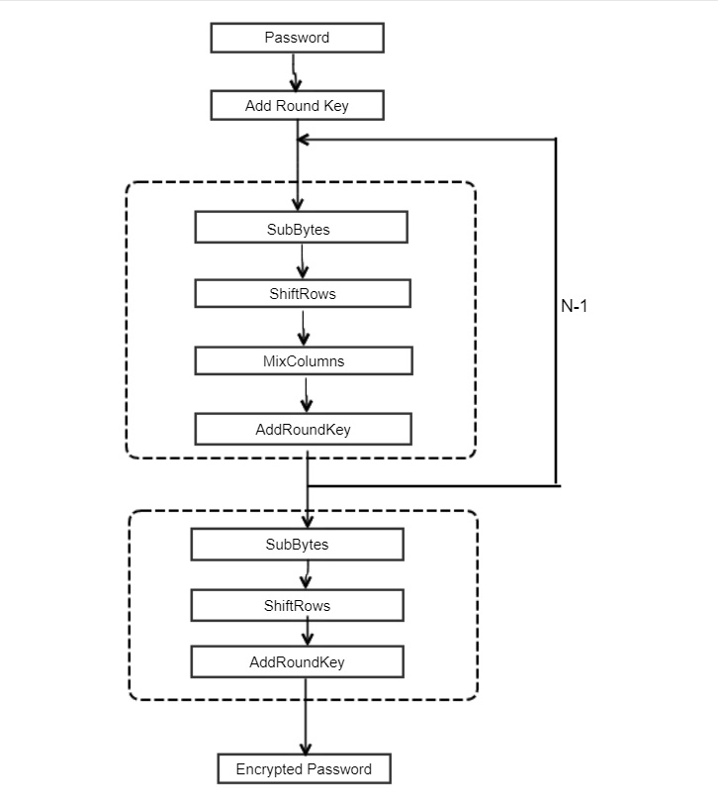
IMPLEMENTATION
Encryption

Slide 12

IMPLEMENTATION
Decryption

Slide 13
IMPLEMENTATION
Overview of Tools/Technologies Used
Eclipse IDE
Eclipse is an integrated development environment used in computer programming. It consists of a base workspace and plugins for customizing the environment. By visiting the official site of eclipse one can easily download the IDE and use it to develop efficient projects. The pre-requisite for the installation of eclipse IDE is to have a Java Development Kit (JDK) present in the system.
Eclipse ADT Plugin
The ADT plugin for Eclipse adds extensions to the Eclipse IDE. This extension helps to debug Android applications efficiently.
Apache Tomcat
Apache Tomcat is an open-source implementation of the Java Servlet, JavaServer Pages, Java Expression Language and WebSocket technologies. Tomcat provides a "pure Java" HTTP web server environment in which Java code can run.
SQL Yog
SQLyog is a GUI tool for the RDBMS MySQL. SQLyog is being used by more than 30,000 customers worldwide and has been downloaded more than 2,000,000 times.

Slide 14
IMPLEMENTATION
Implementation Details Of Modules
Module1- Admin login through web interface.
The admin can log in through the web interface developed by providing the admin ID and password and once logged in will be able to view all the user details. Only the admin has the rights to view the master password in the decrypted format so that he/she will be allowed to change the password in certain cases where the user might not be able to access his /her account and a mandatory change of password is needed. The admin also has the provision of changing the admin password also and will be validated once performed and the new password will be recorded in the database.
Module 2- User Registration with master password.
The first time the user wants to login to the application, he/she will be prompted to enter a few details like the username, password, and the master password details. During the registration process an OTP will be sent to the registered mobile number to ensure security. Once the verification of the OTP is completed the user can successfully login to the application and perform the needed functionalities.
Module 3- Sending voice based e-mail
Once the android user successfully logs into the application he/she will be able to compose a mail and send it with voice commands. The user will be prompted by the application to speak out the content of the message and once that is done the mail will be delivered to the respective recipient mentioned by the user again through voice.

Slide 15
IMPLEMENTATION
Module 4- Battery Percentage Alerts
The android user will also be alerted on the batter percentage of the device and in case it is low will be prompted to put it to change immediately. This module makes it easier for the visually impaired user to be aware of the battery life and hence helps in charging it before the device completely switches off.
Module 5- Setting of Remainders
The android user will be able to send remainders and also be able to get the alert on these remainders at the specified time and date.
Module 6- Password retrieval using master password
After the successful login of the user into the application the user can use the master password to retrieve the password list. On successful authentication of the master password the user will be able to view the password list . This use of master password has hence benefited to store the password details of other sites in one place for easy access for the visually impaired. If the authentication of the master password is not successful then the password list will not be displayed. The user can also change the master password. If the user wishes to do so then an OTP will be sent to the registered phone number using which the password can be changed. This change of password will be validated and if it is successful it will be stored successfully in the database.

Slide 16
IMPLEMENTATION
Module 7- Password retrieval using voice
After the successful registration of the user the server verifies the details entered the user will be able to add the password details into the application which will be encrypted and stored in the database. If the user wishes to retrieve the password details for a particular domain, the user will speak out the domain name. If the domain name is registered in Google API’s, the password details of that respective domain is retrieved and decrypted made available to the user.
Module 8- Change Settings
The user will be able to make important edits to the settings entered during the first time registration. The changes in the settings will require the master password and on successful verification of the master password the settings can be changed and saved.
Module 9- Change the login password
The user can change the login password of the application if necessary and for security reasons. He/she can do so by first getting the master password validated and on successfully validation the user will be able to change the login password to a new one.
Module 10-View Profile
The user will also be given the provision to view the profile details . In case any changes have to be made to the profile values the master password can be used as the bridge to validate the identity of the user and on successful validation the user can make edits and view the new profile details.

Slide 17
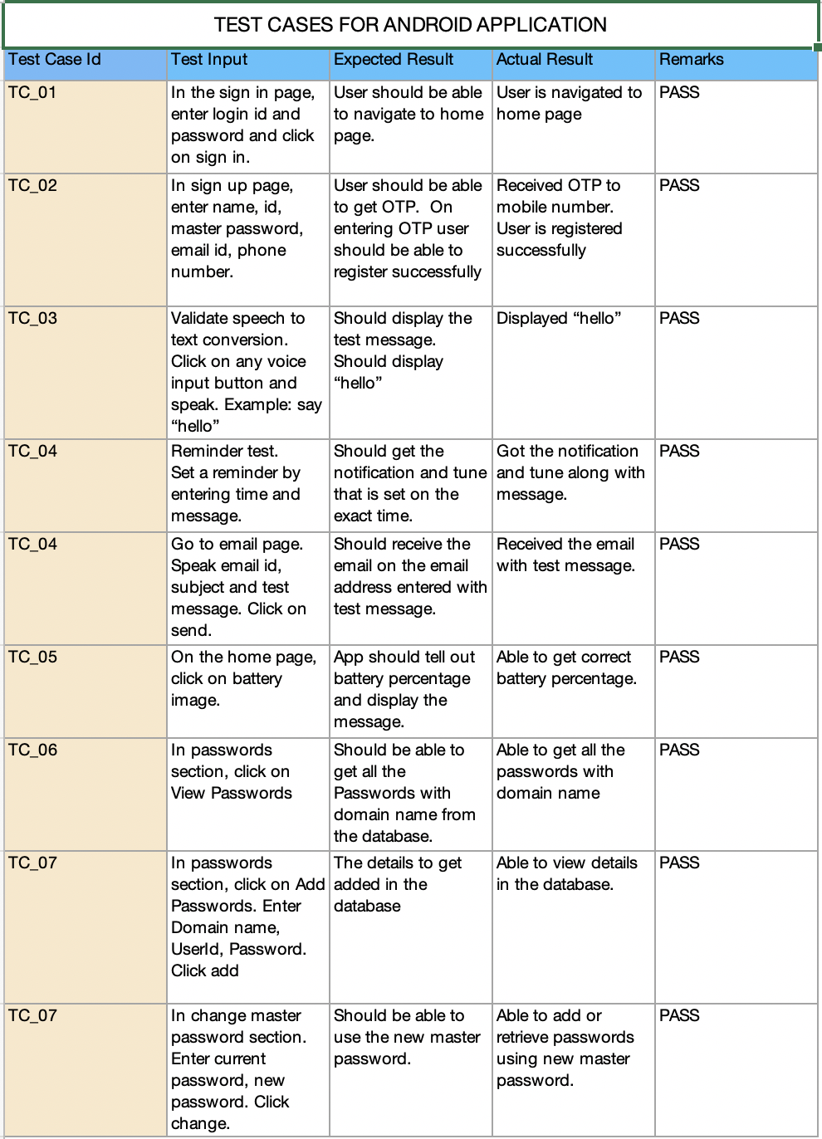
TESTING
Test Case Validations
Test Cases for Android application

Slide 18
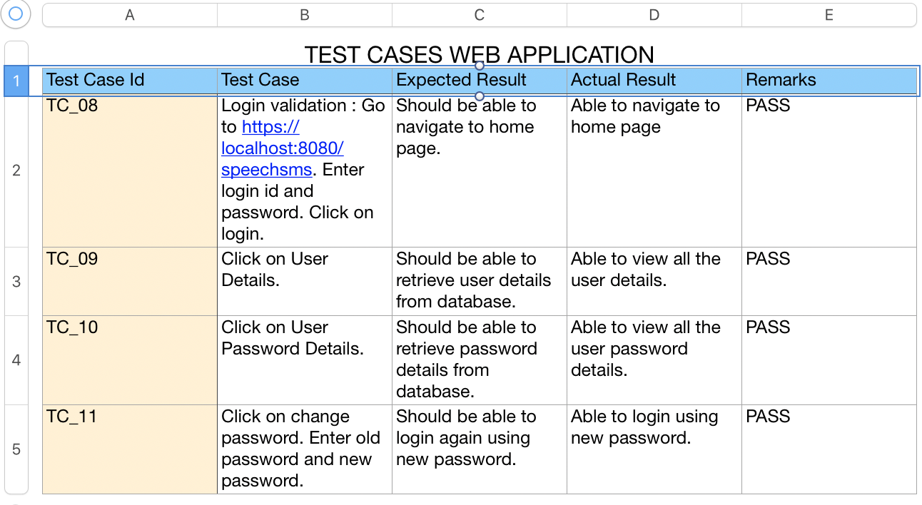
TESTING
Test cases for web application

Slide 19
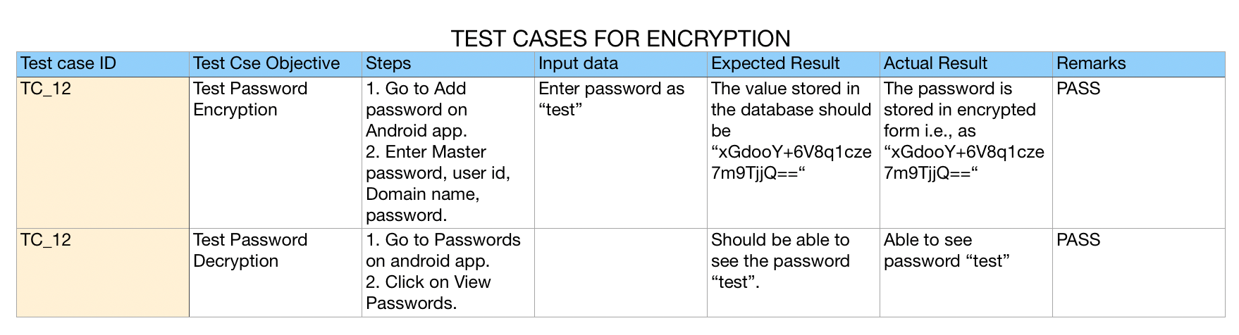
TESTING
Test cases for encryption

Slide 20
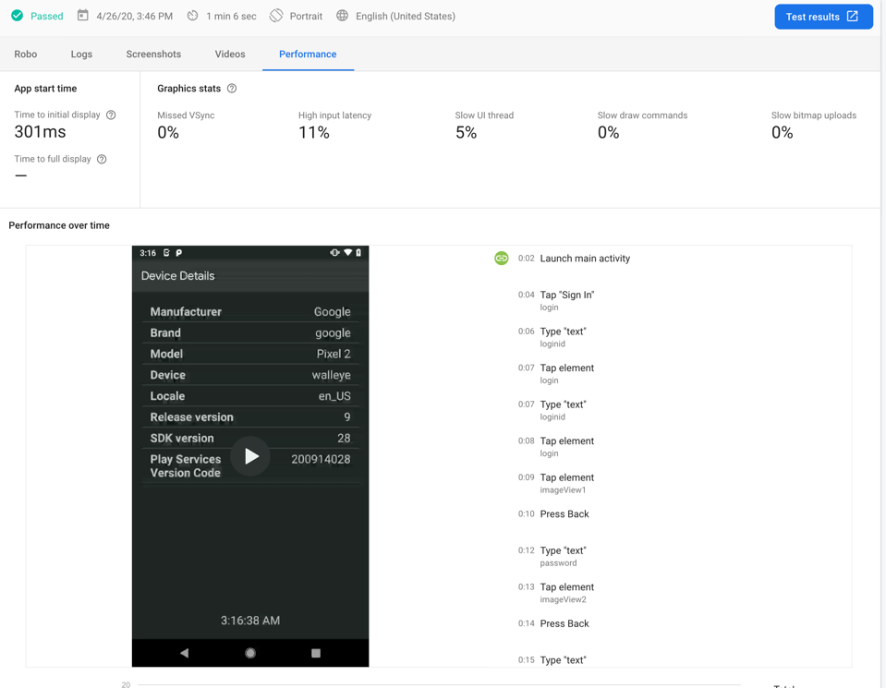
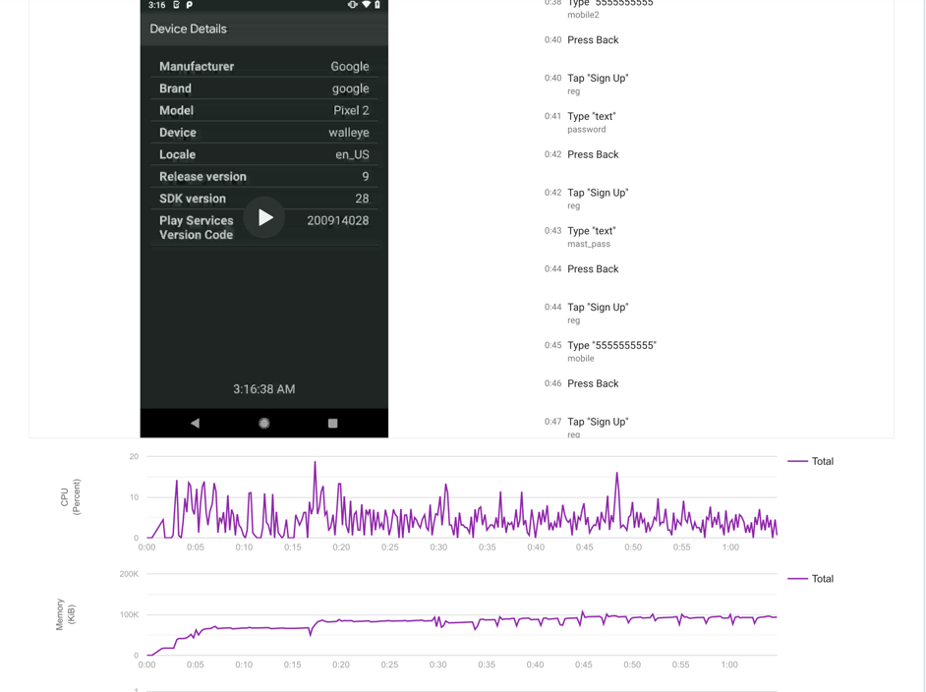
TESTING
The Firebase TestLab provides an easy environment for testing the developed application to see whether the application is functioning correctly or not. It displays the sequence of events that occur and also displays the CPU utilization and memory usage.

Slide 21
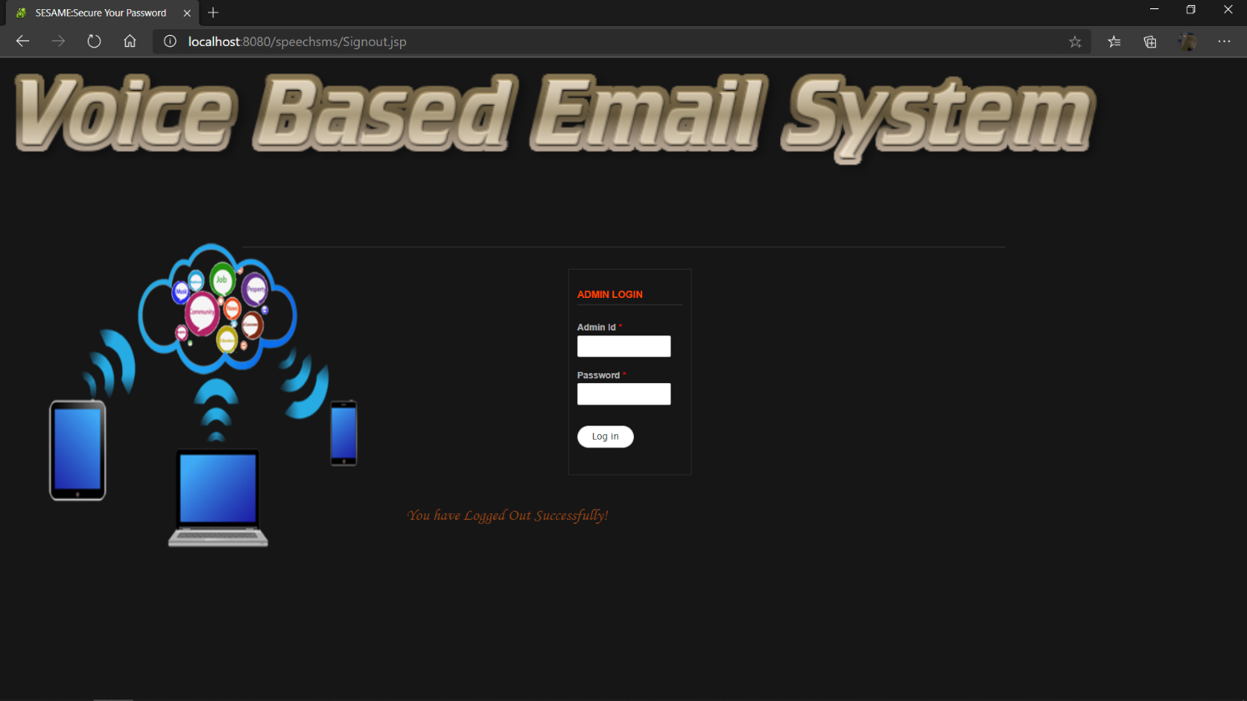
RESULTS/OUTPUT SNAPSHOTS

Slide 22
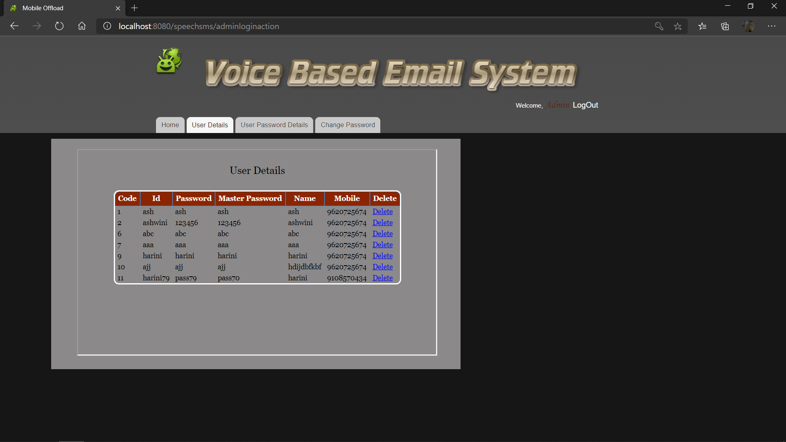
RESULTS/OUTPUT SNAPSHOTS

Slide 23
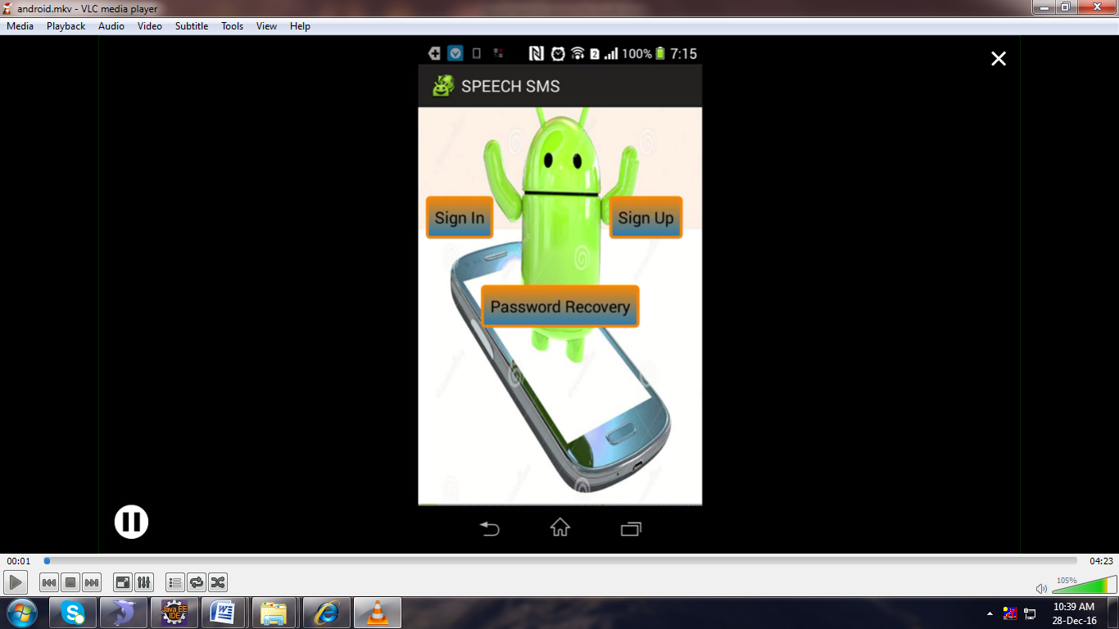
RESULTS/OUTPUT SNAPSHOTS

Slide 24
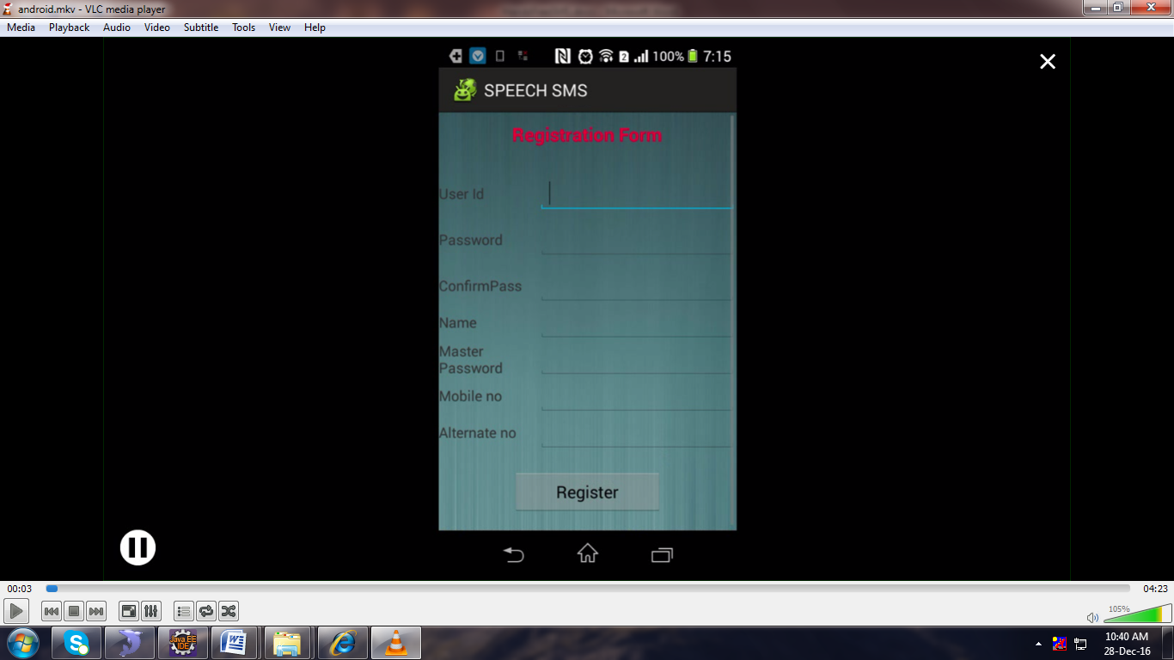
RESULTS/OUTPUT SNAPSHOTS

Slide 25
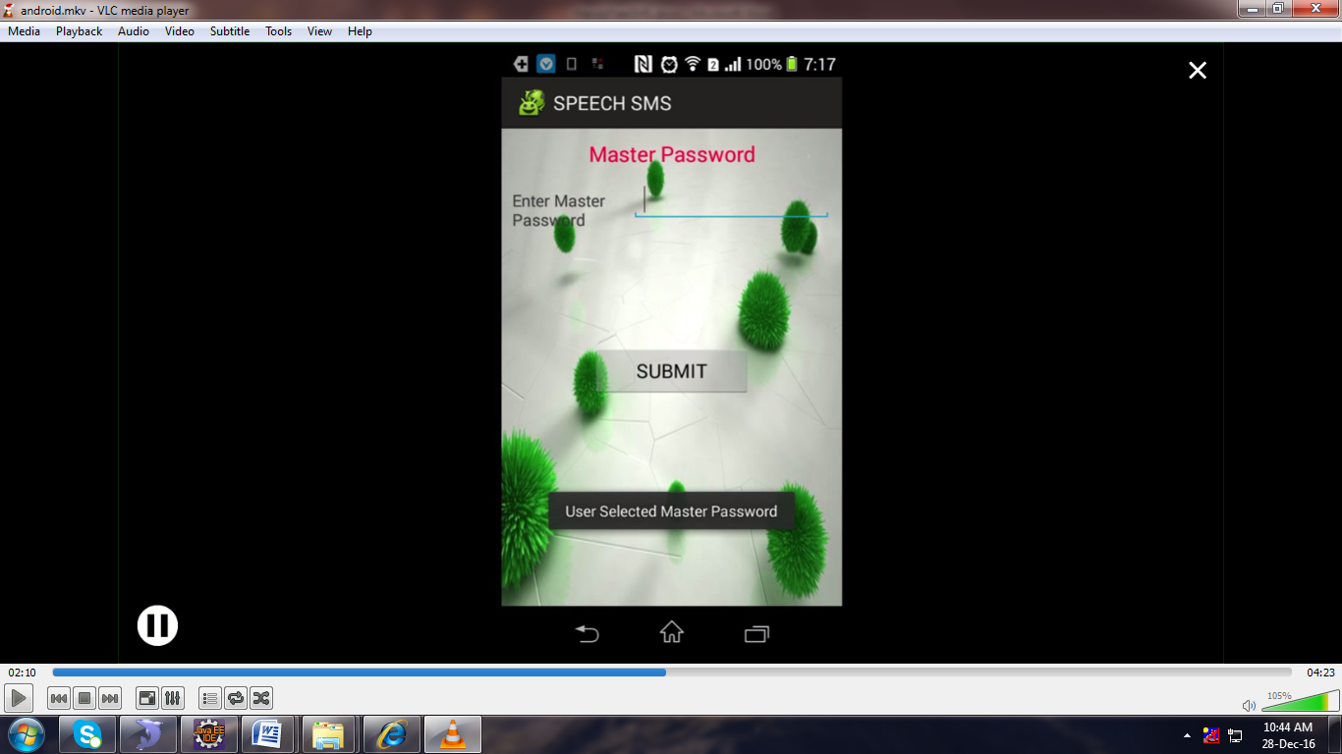
RESULTS/OUTPUT SNAPSHOTS

Slide 26
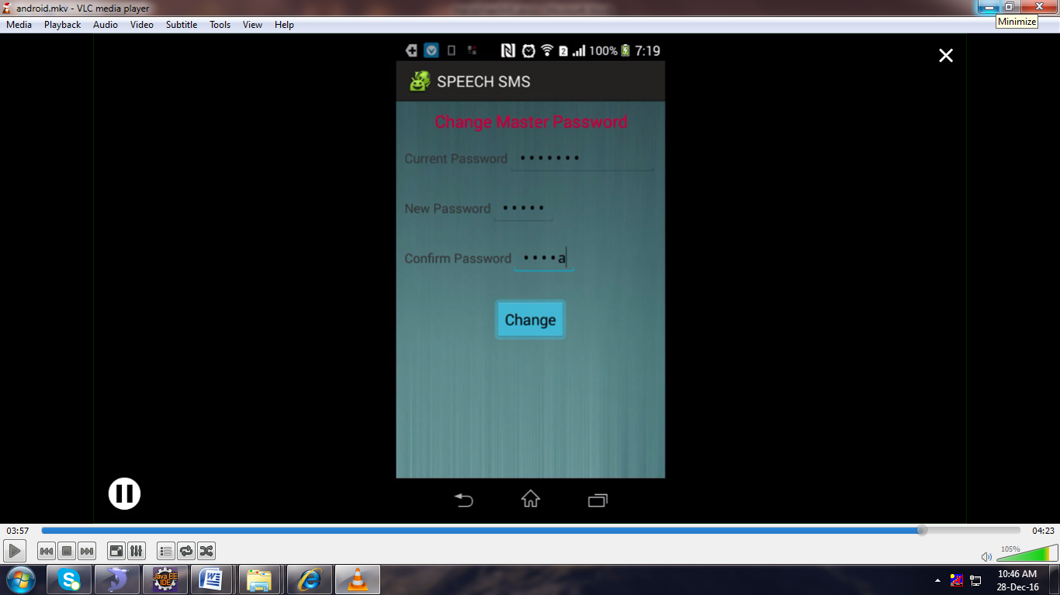
RESULTS/OUTPUT SNAPSHOTS

Slide 27
CONCLUSION AND FUTURE ENCHANCEMENTS
In conclusion this system is a mobile application created for the visually impaired so that they can make use of this app to send emails, set reminders and get to know about their battery percentage.
Currently this application is not available on the Play Store, in future it would be better if this application was made available on the Play Store.

Slide 28
PAPER PUBLISHED
Author Names: PRADEEP SADANAND, KRITHIKA.G.M, DEEPTHI.R, ZAINA AHAD, HARINI.B.M
Paper Title: Voice Based Application for visually impaired
Name of the Conference or Journal: International Journal Of Innovative Research In Science, Engineering and Research.
Volume 9, Issue 4, April 2020.

Slide 29
REFERENCES
[1] Jin-hee Lee, aSang-Chul Lee, aKyeongyul Kim, and aByeong-Seok Shin, “Smarta Backpacka for Visually Impaired Person”, International Conference on ICT for Smart Society-IEEE, June 2013.
[2] Varit Prudtipongpun, Thorntita Rattanapongsen, Wirawan Buakeaw and Mingmanas Sivaraksa, “Indoor Navigation System for Vision-impaired Individual”, IEEE-International Conference on Signal-Image Technology & Internet-Based Systems (SITIS), 2015.
[3] Zewen Li, Gang Luo and Shrinivas Pundlik, “Stabilization of Magnified Videos on a Mobile Device for Visually Impaired”, IEEE Conference on Computer Vision and Pattern Recognition Workshops, 2013.
[4] R.Kasthuri, B.Nivetha, S.Shabana, V.Veluchamy, S.Shivakumar 2017 Third International Conference on Science Technology Engineering & Management (ICONSTEM), “Smart device for visually impaired people” .
[5] Carmel Mary Belinda M.J. , Rupavathy.N , Mahalakshmi N R, International Journal of Engineering and Technology(2016), “A voice based text mail system for visually impaired”.
[6] Jayachandran .K, Anbumani .P, International Journal of Advance Research, Ideas and Innovations in Technology (2017), “Voice Based Email for Blind People”.
[7] Jing-zhong wang, xiao-hui guo, ke xiao, 2016 IEEE, “research and implementation of blind reader system based on android platform.”
[8] Piotr Kardyś, Adam Dąbrowski , Marcin Iwanowski, Damian Huderek 2016 IEEE, “A new Android application for blind and visually impaired people”.

Slide 30
THANK YOU

